Slide 1


Hand Landmark Detection
Piano Keyboard Detection Experiments using YOLOv5
Aug 3rd, 2023
To. professor

Slide 2
Hand Landmark Detection
Index_
1. Datasets
2. Training model
3. Comparison of the results between models
4. Inference

Slide 3
Hand Landmark Detection
1. Datasets

Slide 4


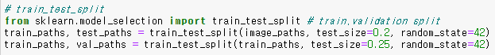
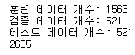
1. Datasets
There are 2,605 images for model training.
First, Dataset was split at a ratio 6:2:2 by sckit learn for model training.
type | train | validation | test
keyboard | 1563 | 521 | 521
1

Slide 5
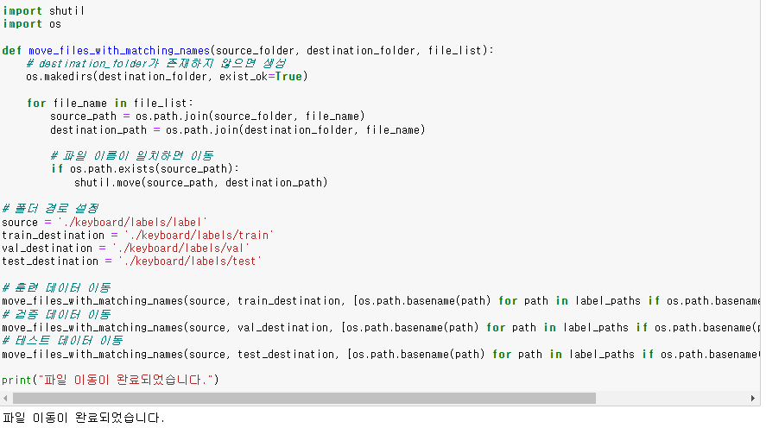
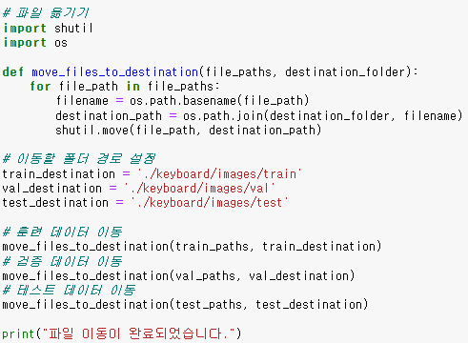
1. Datasets
Second, I moved image files and labeled files to the appropriate path by coded.
2

Slide 6
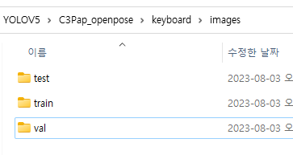
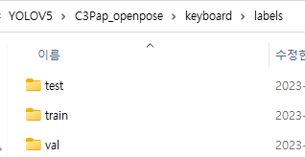
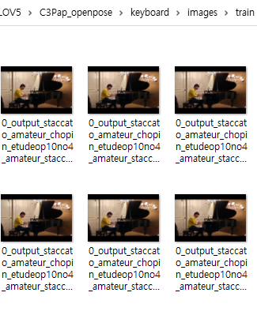
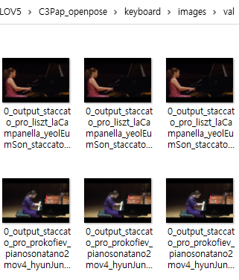
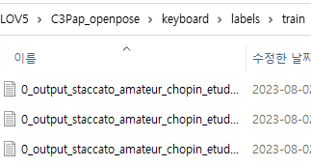
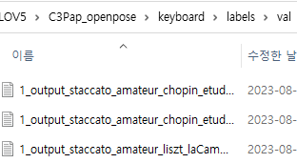
1. Datasets
Directories
3

Slide 7
Hand Landmark Detection
2. Training model

Slide 8
2. Training model
The hyperparameters used to train the model are:
--batch 16 --epochs 100 --weights yolov5s.pt
--batch 16 --epochs 50 --weights yolov5s.pt
--batch 16 --epochs 500 --weights yolov5s.pt (However, the training ended at the 368th training.)
In summary, only the number of epochs had changes.
4

Slide 9
Hand Landmark Detection
3. Comparison of the results
between models

Slide 10
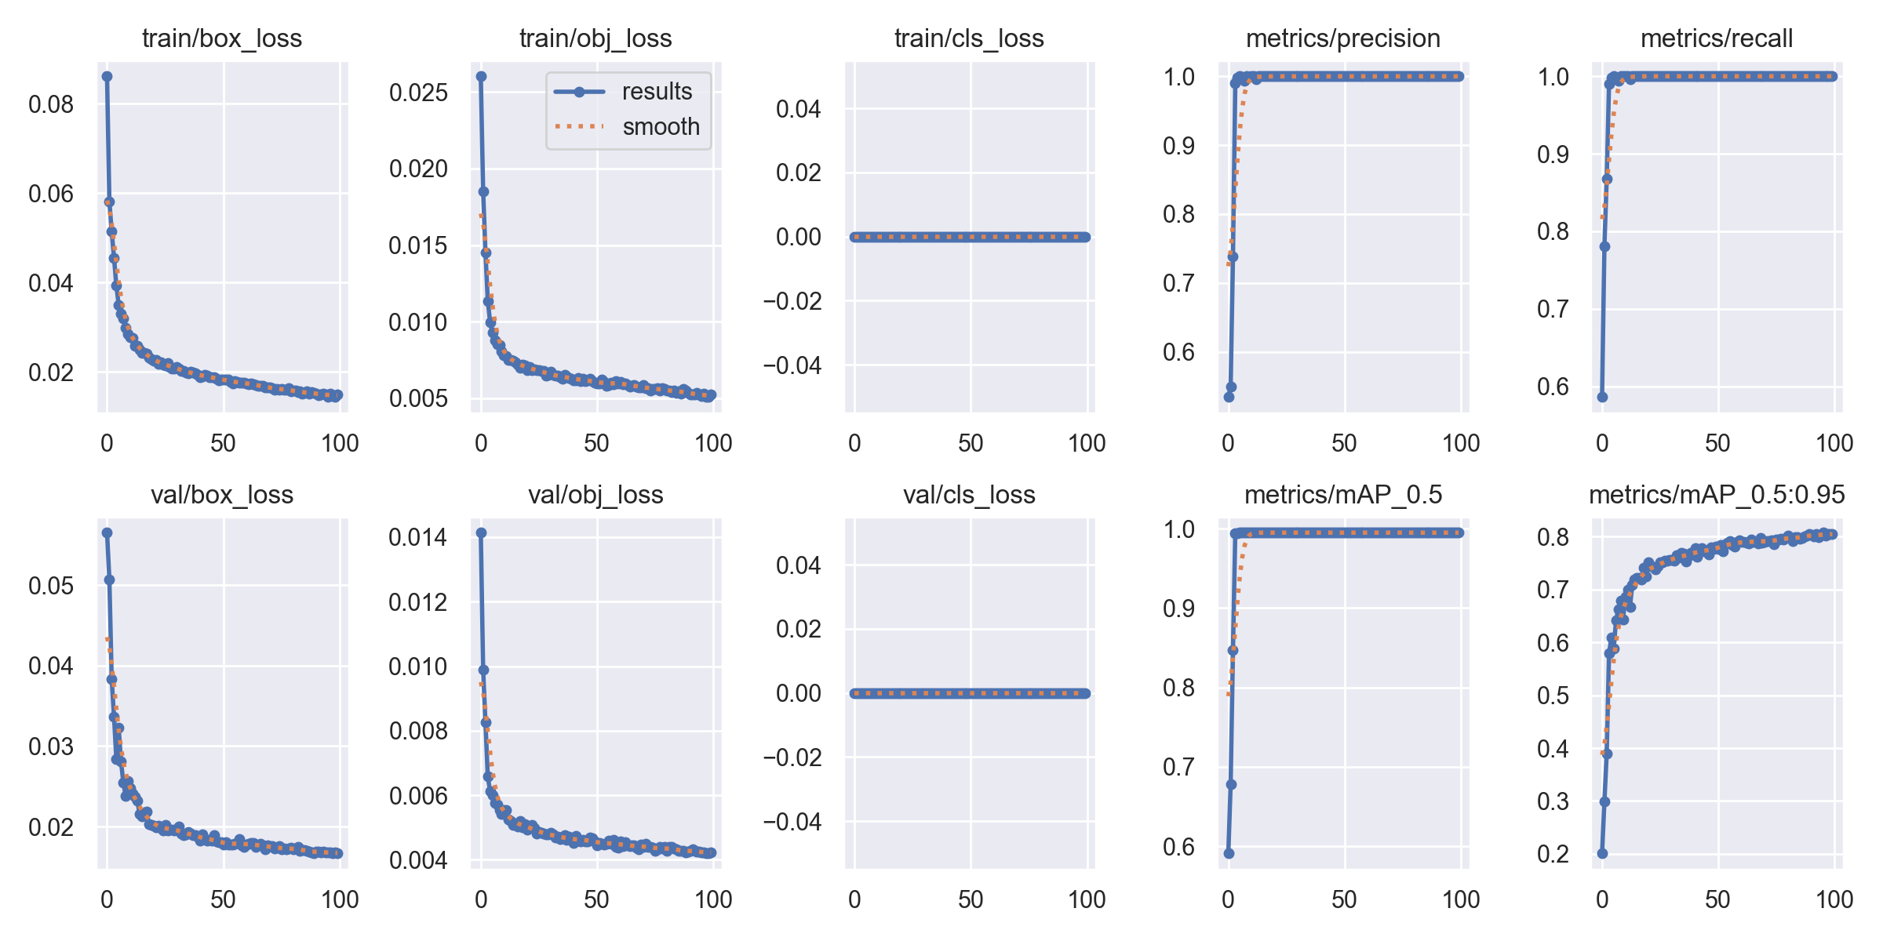
3. Comparison of the results between models
1. A model trained by epochs 100
5

Slide 11
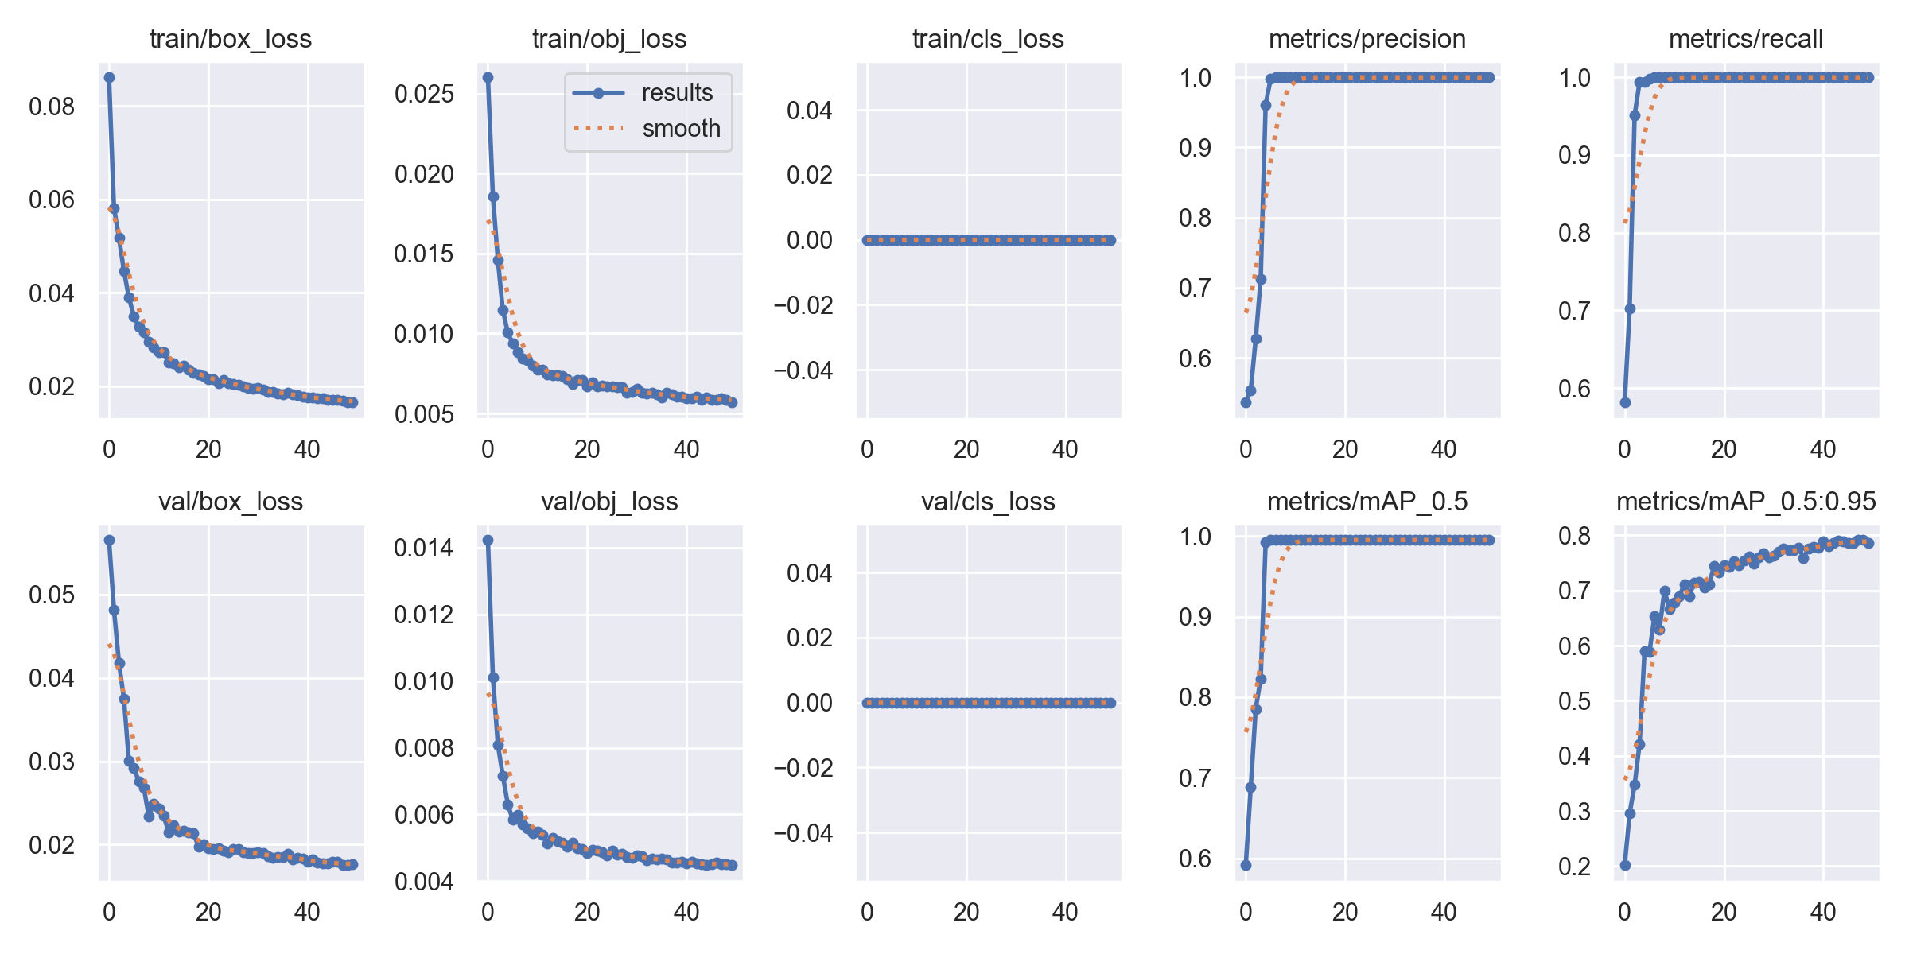
3. Comparison of the results between models
2. A model trained by epochs 50
6

Slide 12
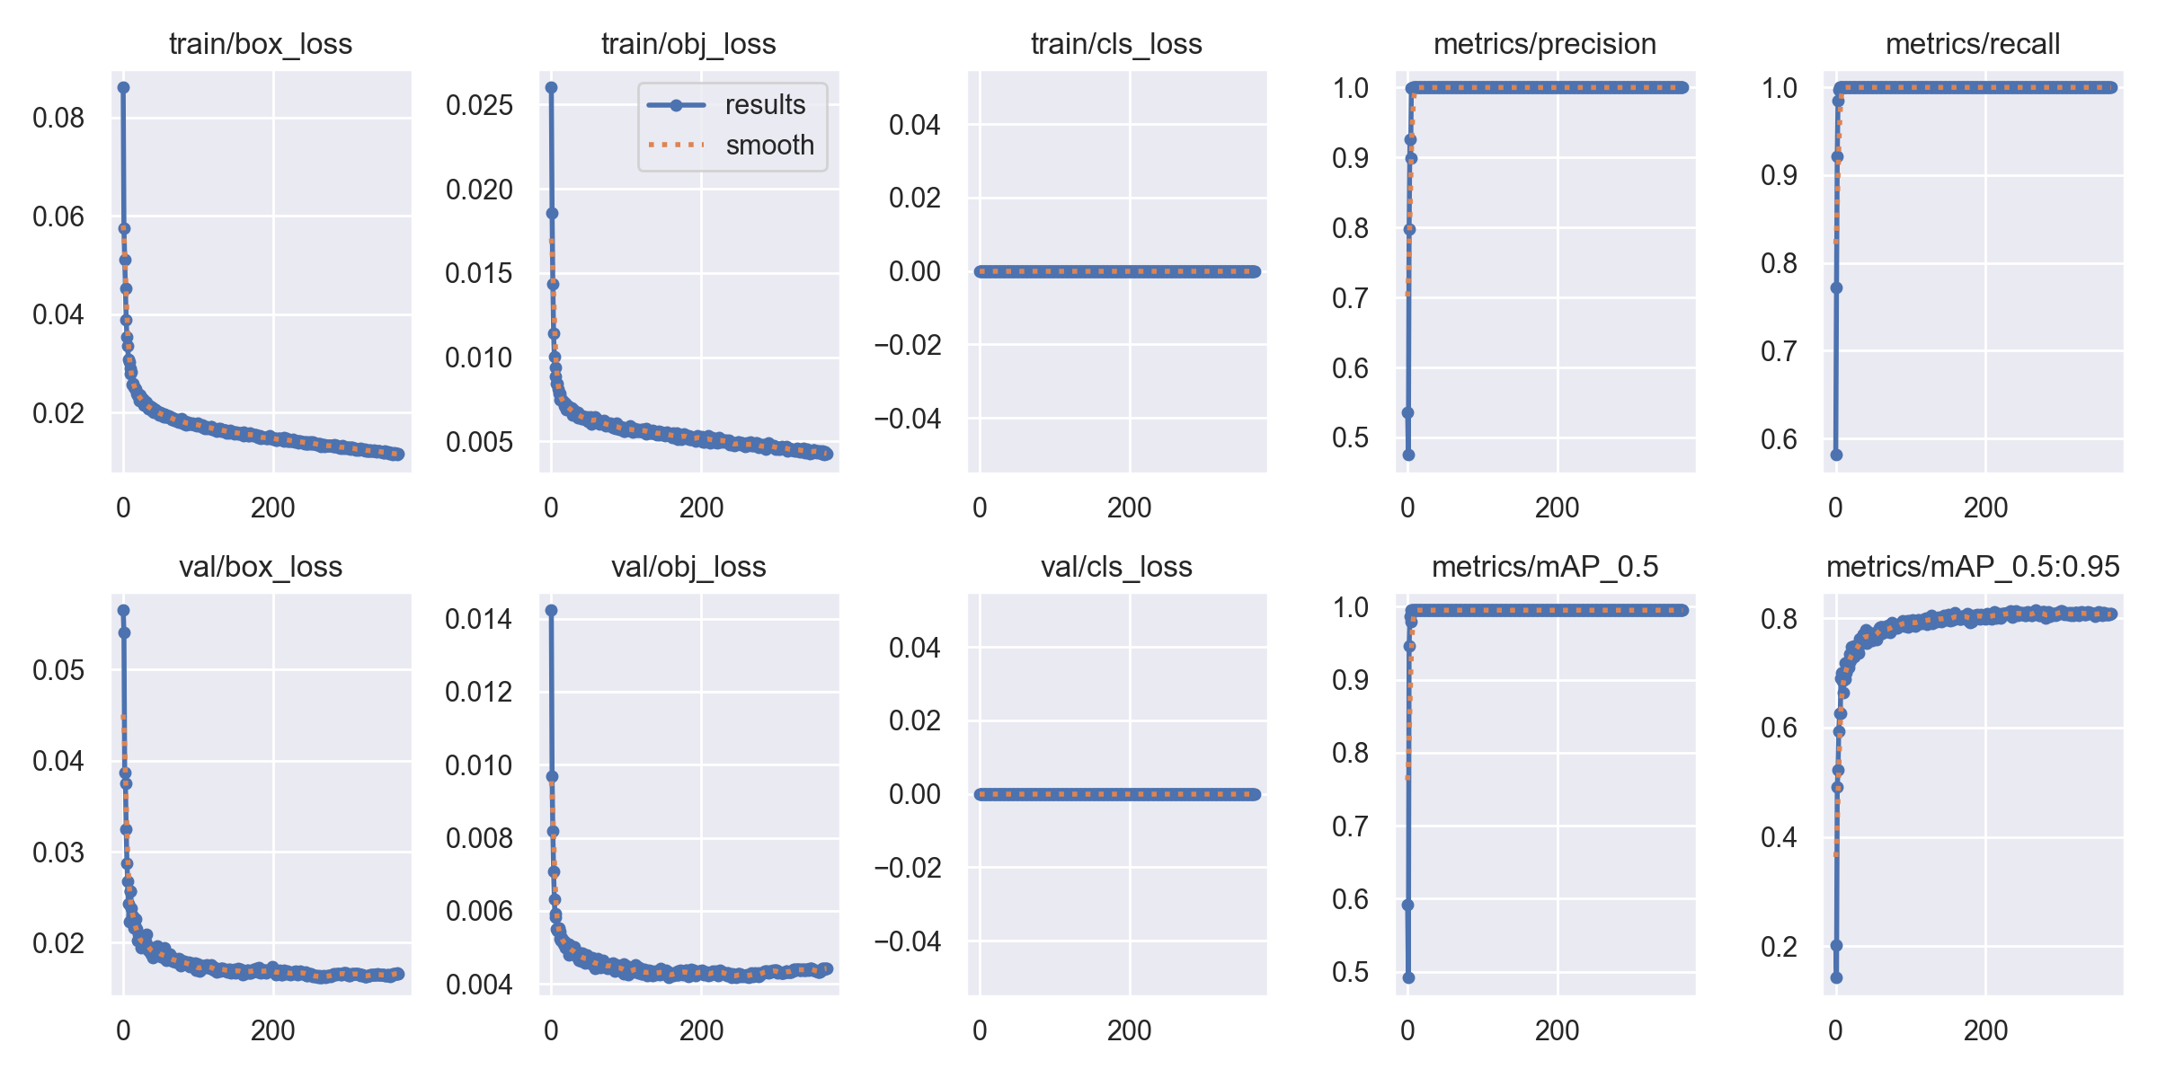
3. Comparison of the results between models
3. A model trained by epochs 368
7

Slide 13
3. Comparison of the accuracy between models
1. A model trained by epochs 100
2. A model trained by epochs 50
3. A model trained by epochs 368
precision: 0.999
recall: 1
mAP_0.5: 0.995
mAP_0.5:0.95: 0.80534
precision: 0.999
recall: 1
mAP_0.5: 0.995
mAP_0.5:0.95: 0.78612
precision: 0.999
recall: 1
mAP_0.5: 0.995
mAP_0.5:0.95: 0.808
8

Slide 14
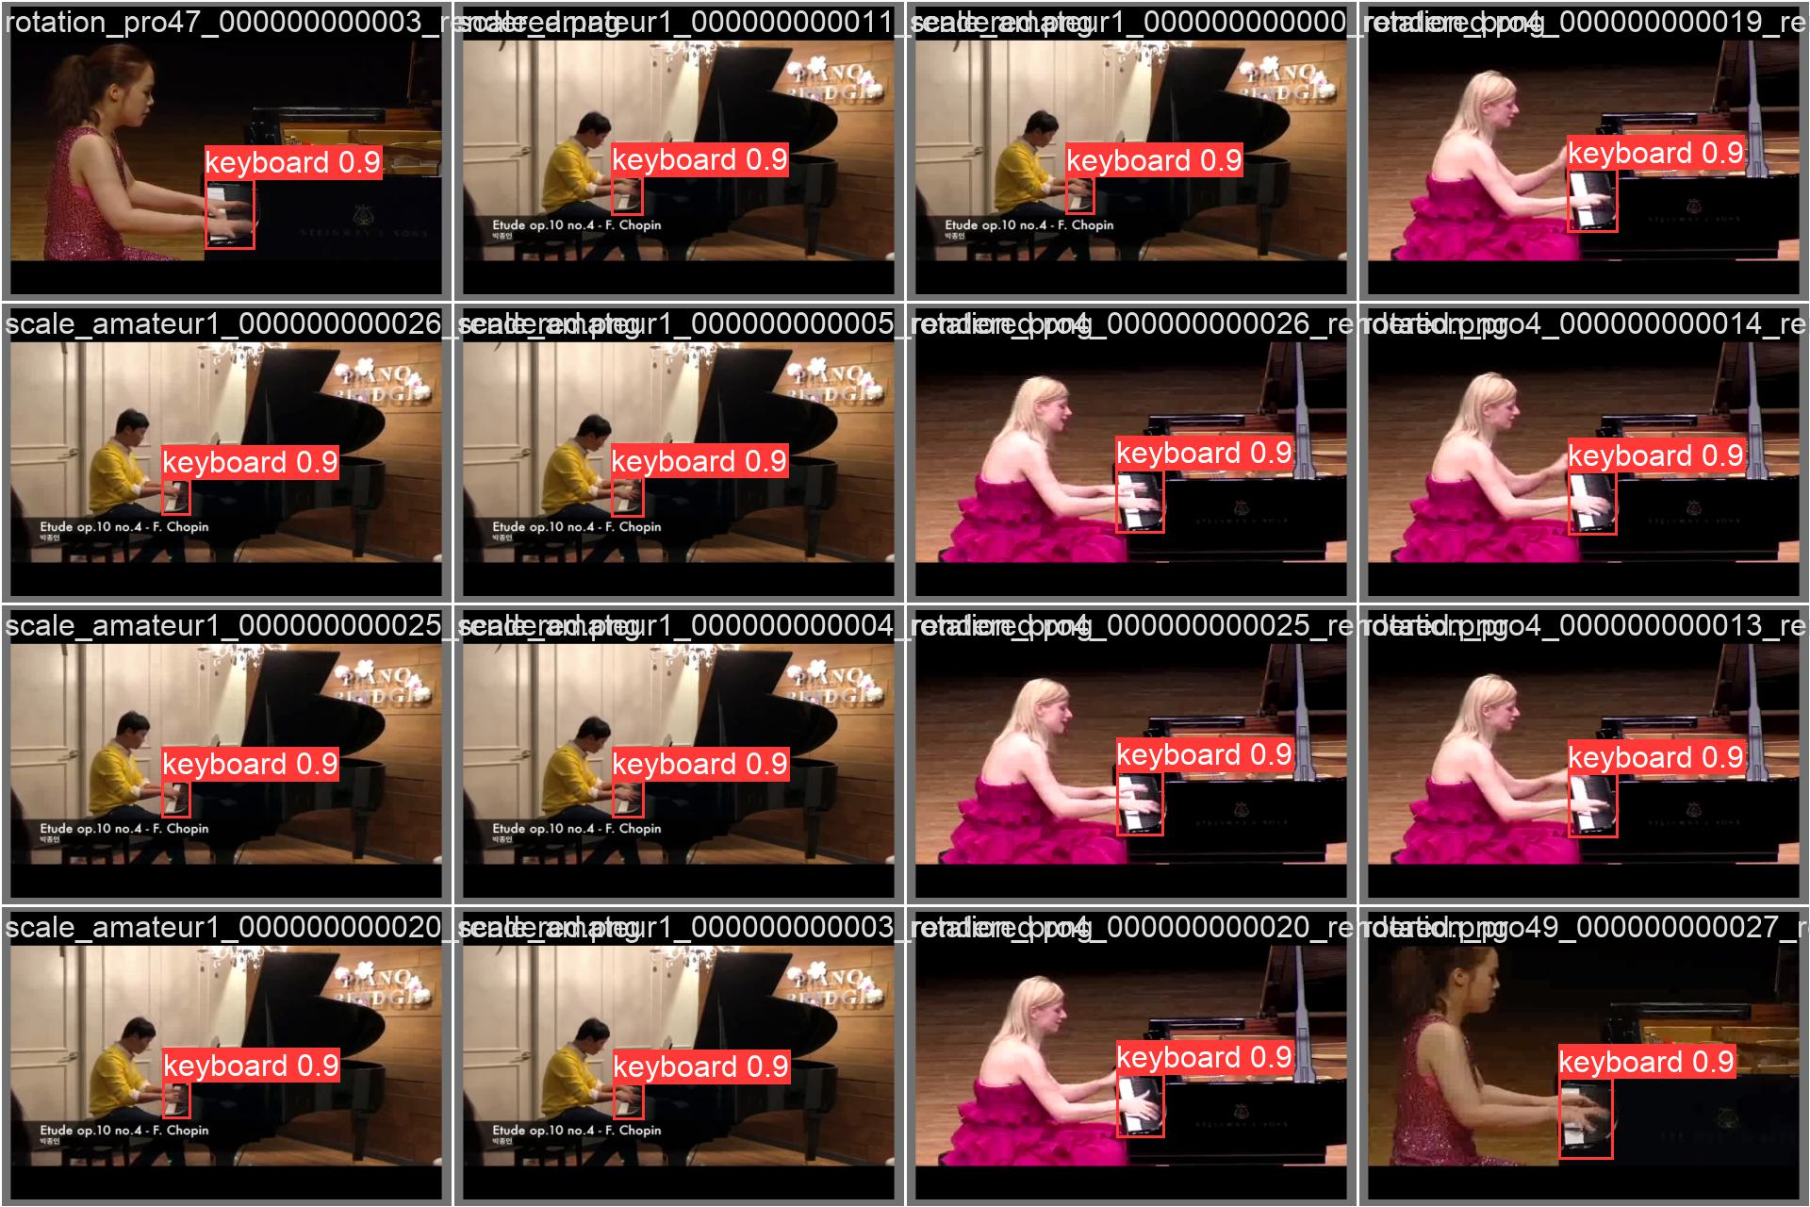
3. Comparison of the results between models
1. A model trained by epochs 100 - val
9

Slide 15
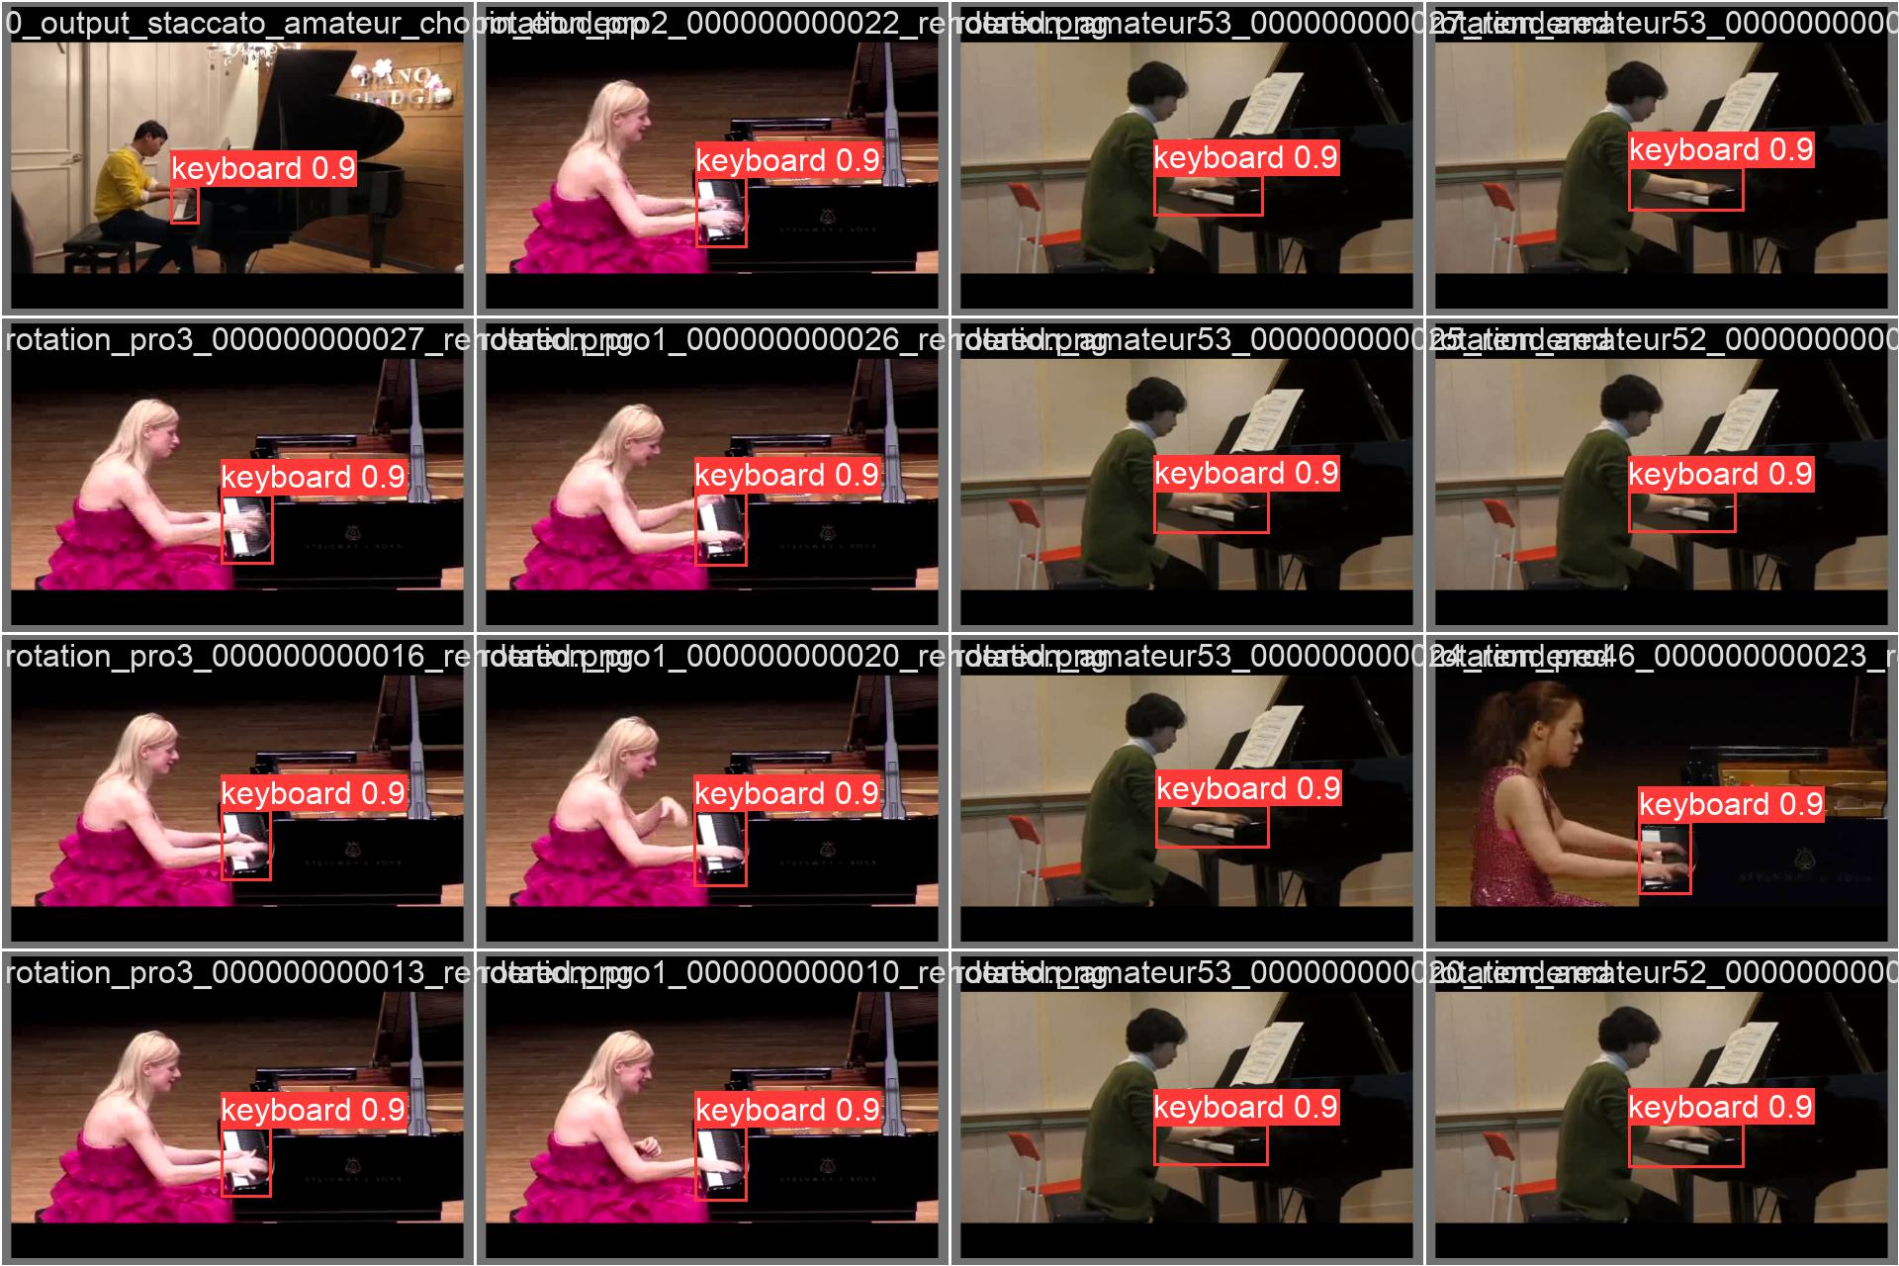
3. Comparison of the results between models
2. A model trained by epochs 50 - val
10

Slide 16

3. Comparison of the results between models
3. A model trained by epochs 368 - val
11

Slide 17
Hand Landmark Detection
4. Inference
For the test, I conducted a test with 10 images already had and 10 images collected by searching for 'playing piano' on Google.

Slide 18
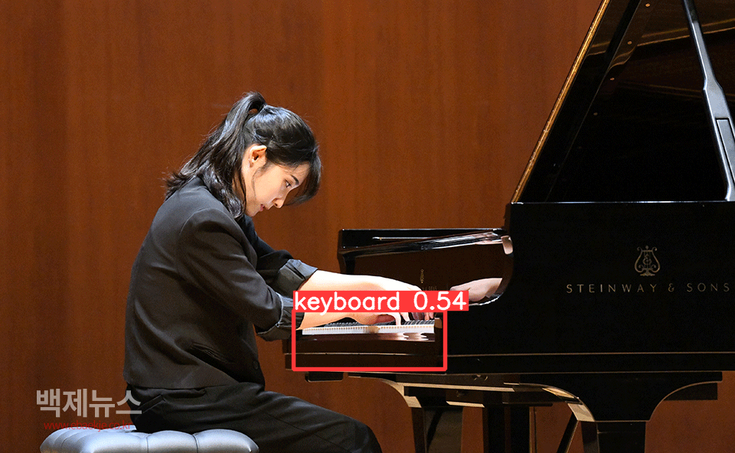
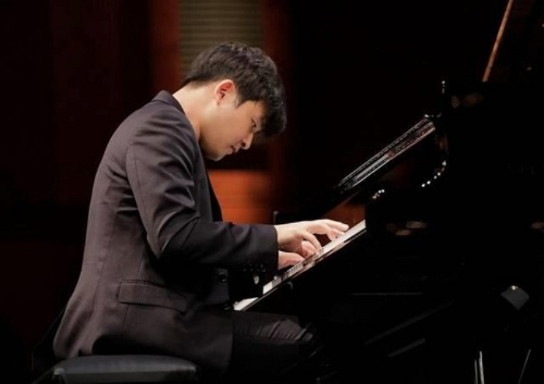
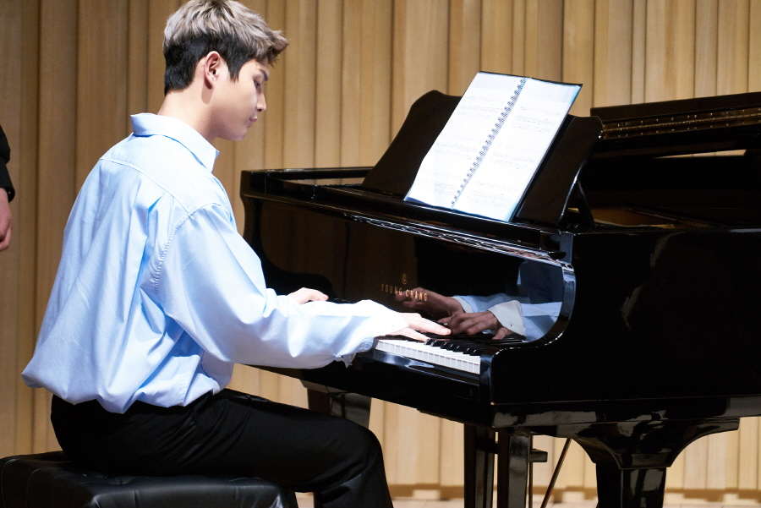
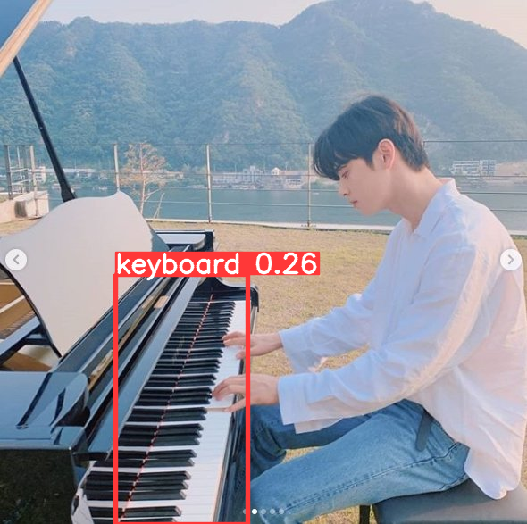
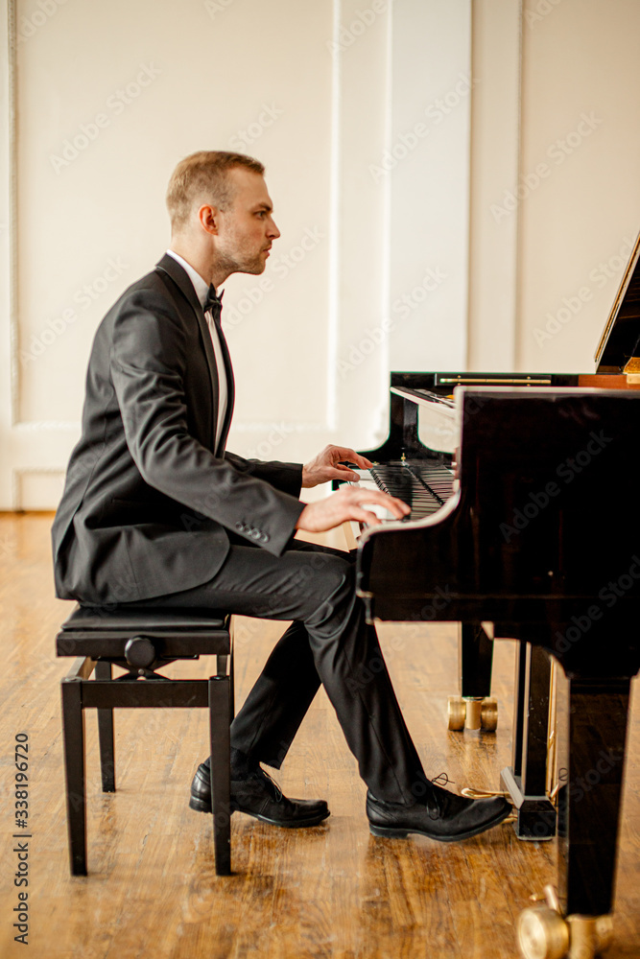
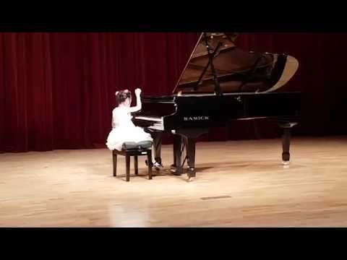
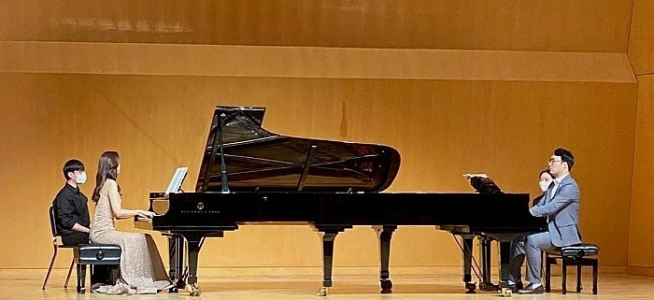
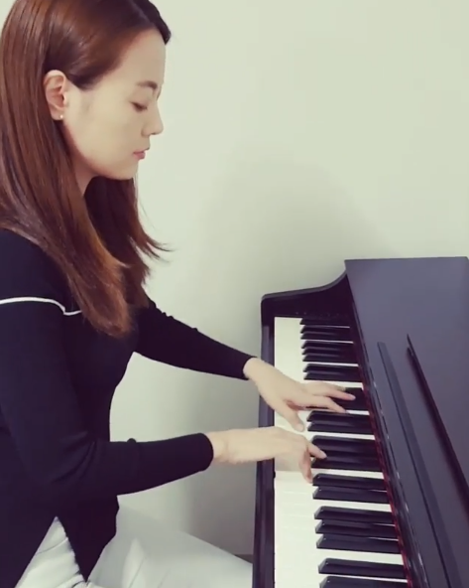
4. Inference - A model trained by epochs 100 (1)
12

Slide 19
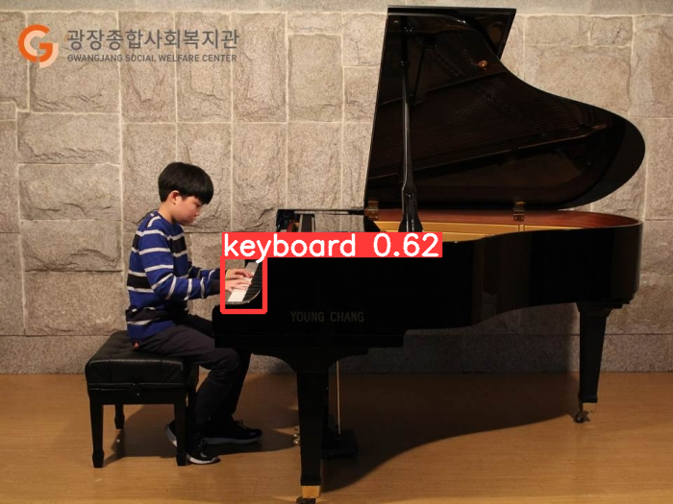
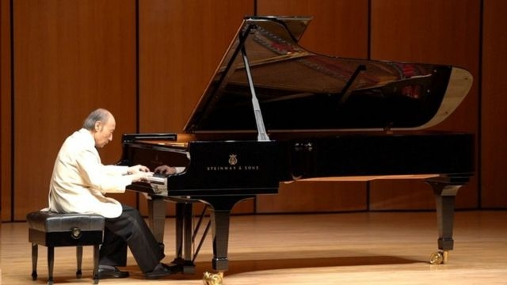
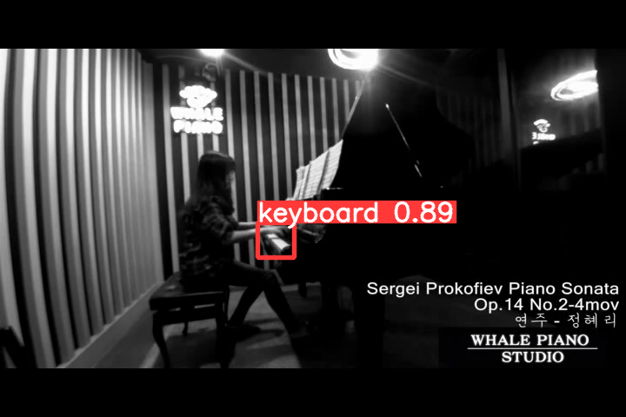
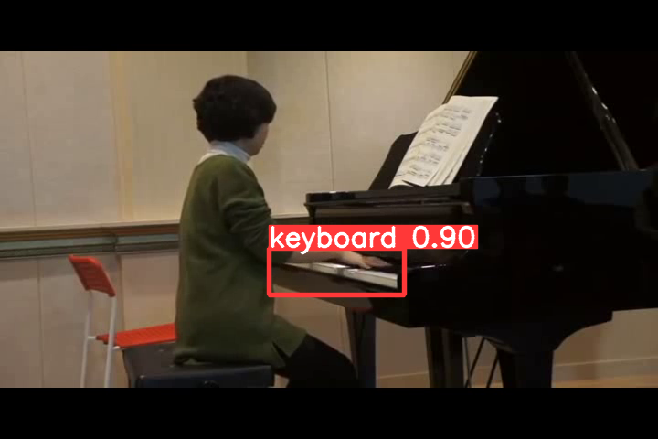
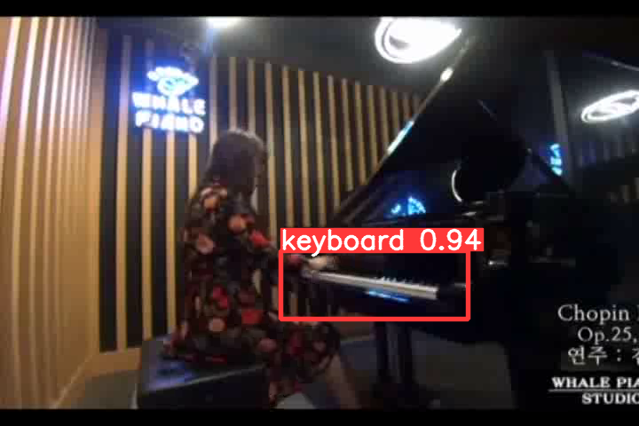
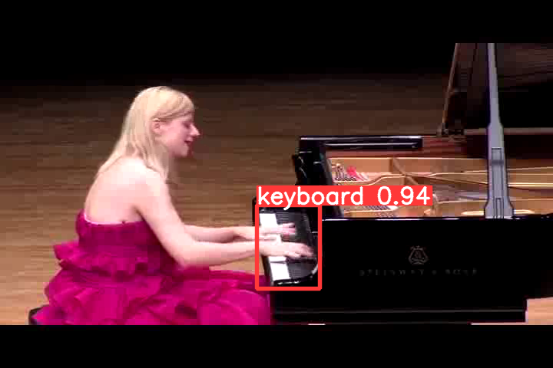
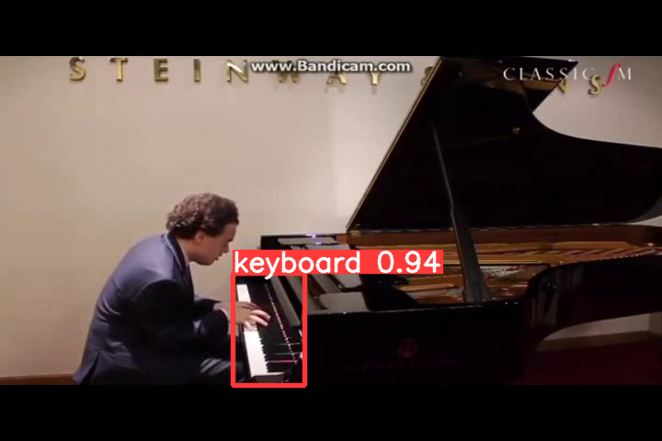
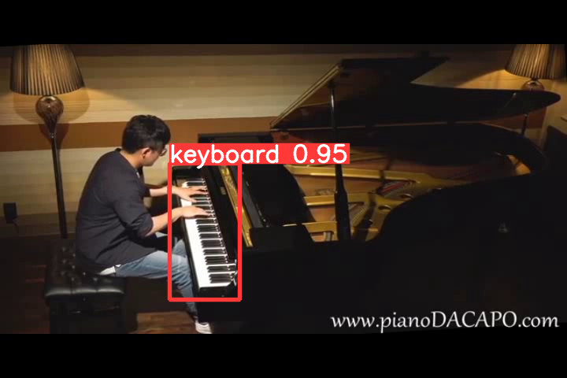
4. Inference - A model trained by epochs 100 (2)
13

Slide 20
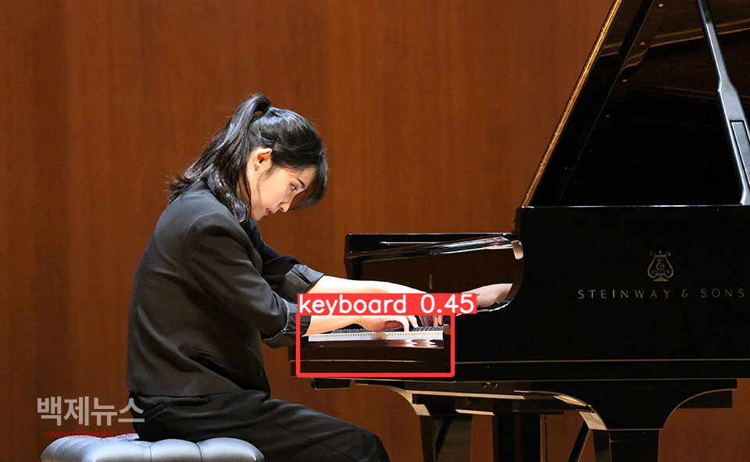
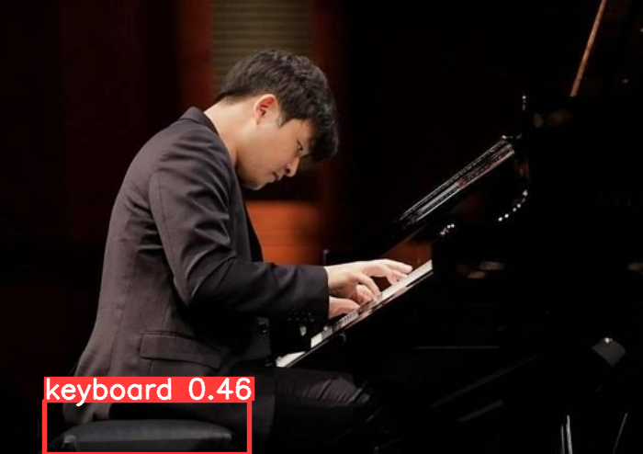
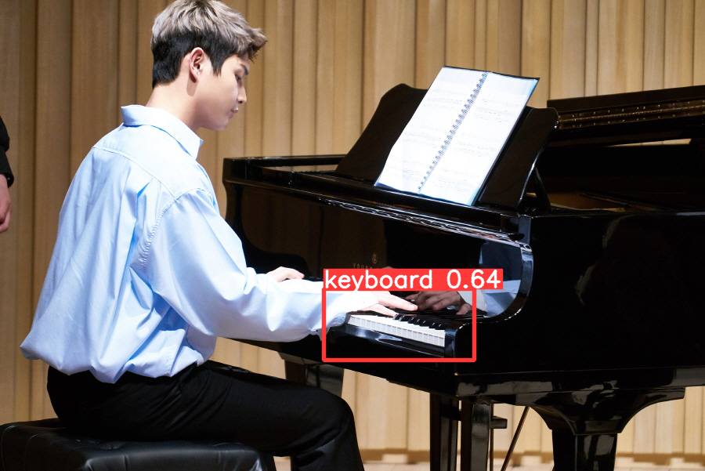
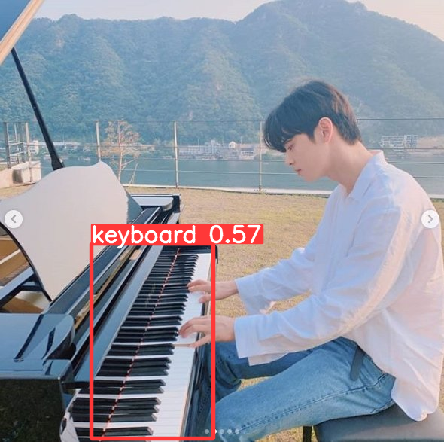
4. Inference - A model trained by epochs 50 (1)
14

Slide 21







4. Inference - A model trained by epochs 50 (2)
15

Slide 22
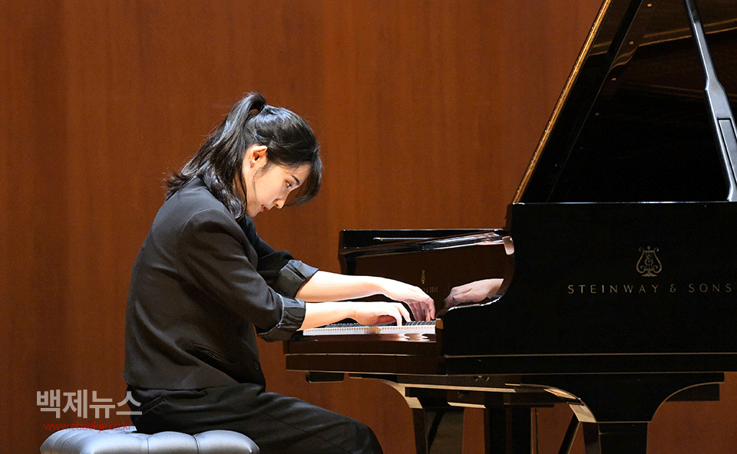


4. Inference - A model trained by epochs 368 (1)
16

Slide 23



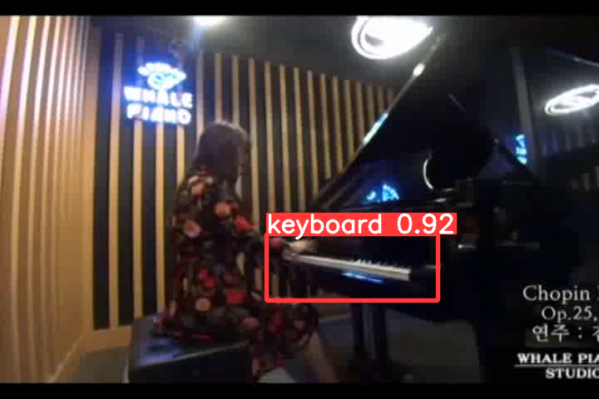

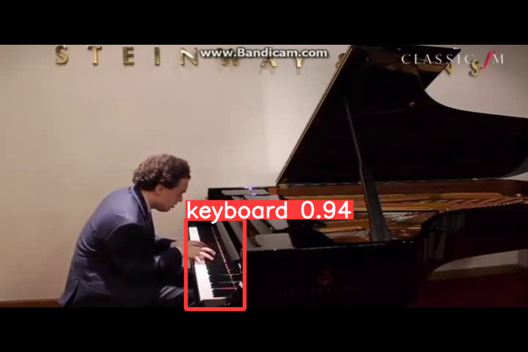

4. Inference - A model trained by epochs 368 (2)
17

